Slide 1
An overview of python
Introduction to python for hydrologists
Pyle Center - UW Campus, Madison, WI
November 18-20, 2019
Photo: Jeff Miller
https://news.wisc.edu/its-back-40-years-later-lady-liberty-on-mendota/

Slide 2
Motivations for using Python
Automate tedious, boring and repetitive tasks
Escape limits imposed by other people’s software
Improve quality and efficiency of work
Scientific reproducibility

Slide 3
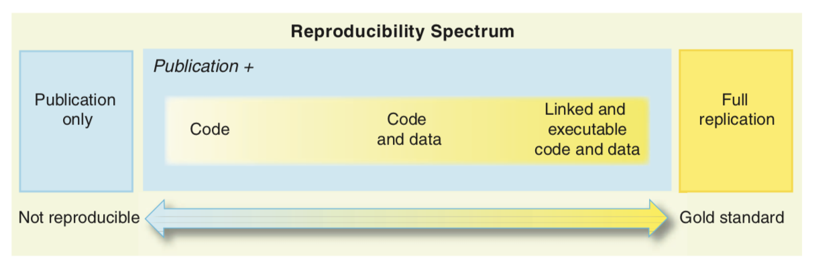
Python and Reproducibility
Peng, R.D. 2011. Reproducible Research in Computational Science, Science 334, p 1226-1227
Hutton, C., T. Wagener, J. Freer, D. Han, C. Duffy, and B. Arheimer (2016), Most computational hydrology is not reproducible, so is it really science?, Water R. Res., 52, 7548–7555, doi:10.1002/2016WR019285.
Ince, D.C., Hatton, L., Graham-Cumming, J., 2012, The case for open computer programs, Nature 482, p 485-488.

Slide 4
What is Python?
Interpreted, high-level language for general-purpose programming
Based on C
Object-oriented
Highly extensible
Besides standard library, large ”ecosystem” of packages for diverse purposes
Emphasizes code readability, simplicity and flexibility
Guido van Rossum
Notes:
...In December 1989, I was looking for a "hobby" programming project that would keep me occupied during the week around Christmas. My office ... would be closed, but I had a home computer, and not much else on my hands. I decided to write an interpreter for the new scripting language I had been thinking about lately: a descendant of ABC that would appeal to Unix/C hackers. I chose Python as a working title for the project, being in a slightly irreverent mood (and a big fan of Monty Python's Flying Circus).
— Guido van Rossum

Slide 5
What does it mean to be pythonic?
Some of the core principals:
Beautiful is better than ugly
Explicit is better than implicit
Simple is better than complex
Complex is better than complicated
Readability counts
https://en.wikipedia.org/wiki/Zen_of_Python
Notes:
...In December 1989, I was looking for a "hobby" programming project that would keep me occupied during the week around Christmas. My office ... would be closed, but I had a home computer, and not much else on my hands. I decided to write an interpreter for the new scripting language I had been thinking about lately: a descendant of ABC that would appeal to Unix/C hackers. I chose Python as a working title for the project, being in a slightly irreverent mood (and a big fan of Monty Python's Flying Circus).
— Guido van Rossum

Slide 6
Advantages
Ease of programming
Well designed language
Modular and object-oriented
Documentation is in the code
Large standard library
Larger collection of add-on packages
Platform-independent
Popular
Free!

Slide 7
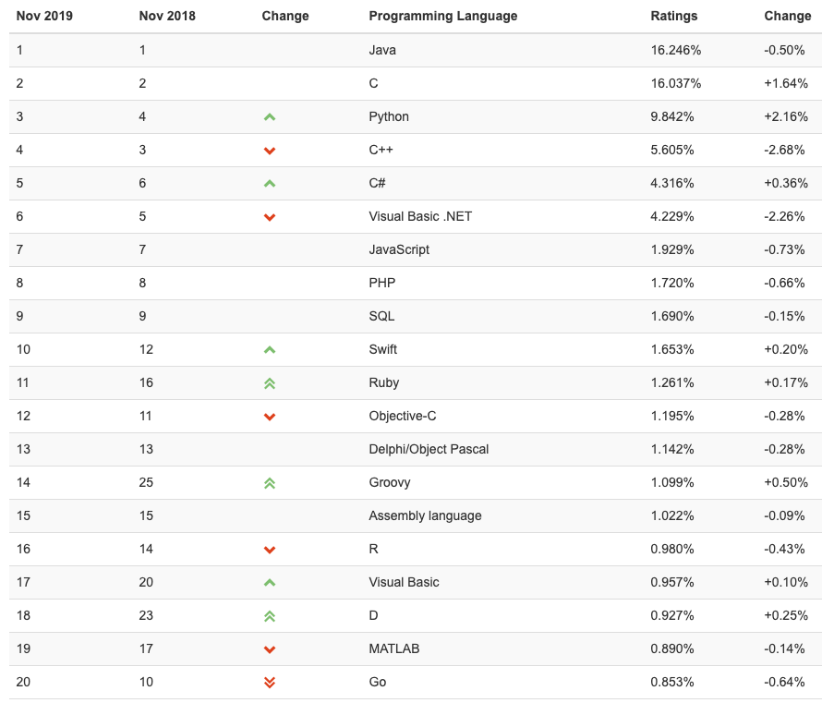
TIOBE Index (November 2019)
https://www.tiobe.com/tiobe-index/
Notes:
The TIOBE Programming Community index is an indicator of the popularity of programming languages. The index is updated once a month. The ratings are based on the number of skilled engineers world-wide, courses and third party vendors. Popular search engines such as Google, Bing, Yahoo!, Wikipedia, Amazon, YouTube and Baidu are used to calculate the ratings. It is important to note that the TIOBE index is not about the best programming language or the language in which most lines of code have been written.
Python has moved up to 3rd since the course was last taught in Colorado in late Feb., 2018.

Slide 8
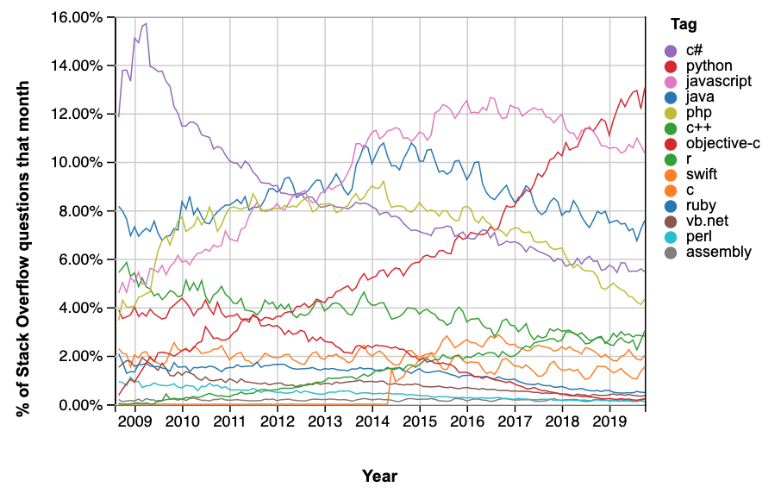
Growth of python
https://insights.stackoverflow.com/trends
Notes:
Based on this blog post: https://blog.pythonanywhere.com/67/, and the graph above, total number of users worldwide might be around 10 million as of 2018.

Slide 9
Disadvantages
Can be slower than other languages
Somewhat decentralized; changes frequently
Installation/Hard to get started
Easy to write bad code
https://towardsdatascience.com/5-reasons-why-jupyter-notebooks-suck-4dc201e27086

Slide 10
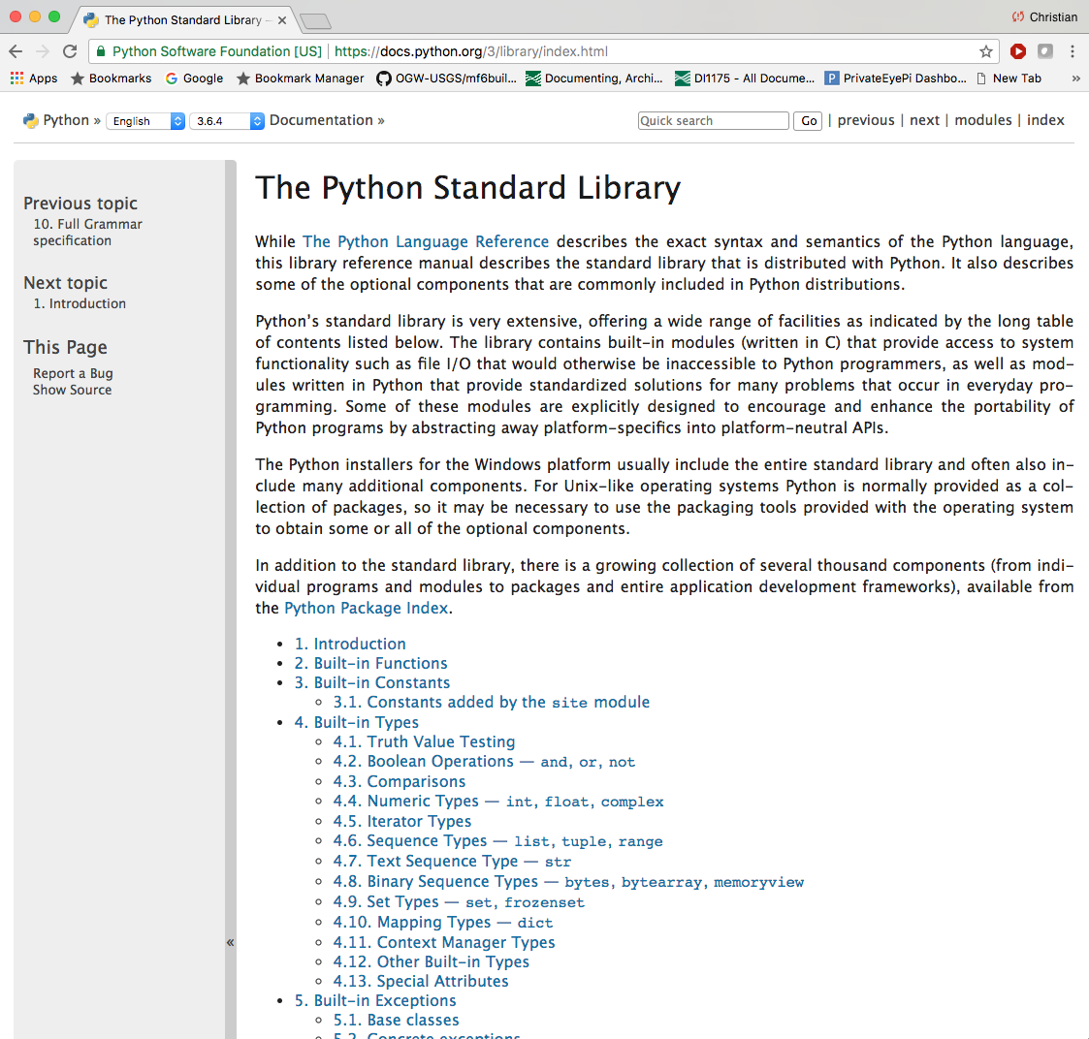
Python Standard Library

Slide 11
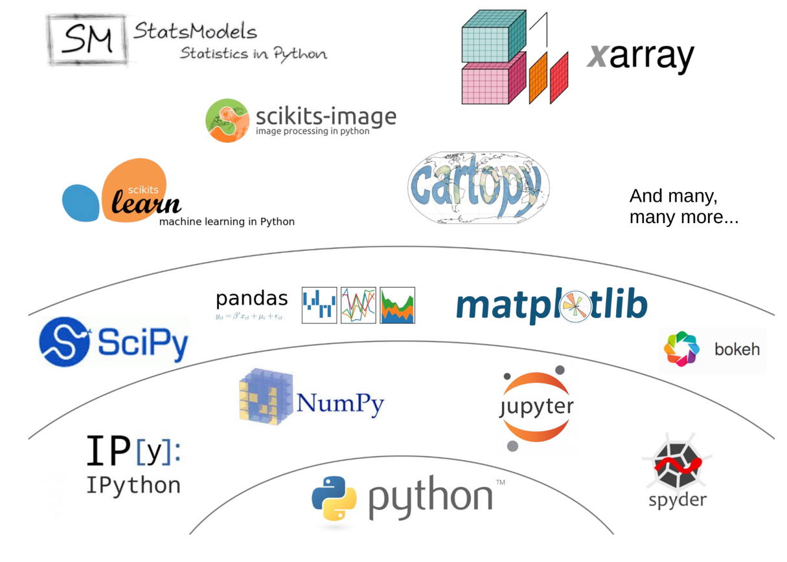
Python's scientific ecosystem
https://fabienmaussion.info/scientific_programming/html/18-Scientific-Python.html
Notes:
Unlike Matlab, the set of Python tools used by scientists does not come from one single source. It is the result of a non-coordinated, chaotic and creative development process originating from a community of volunteers and professionals.

Slide 12
Development Environments
Python interpreter
Ipython
Jupyter Notebook or Jupyter Lab
IDE (integrated development environment) such as Pycharm
Best option for developing “production” or “operational” code

Slide 13
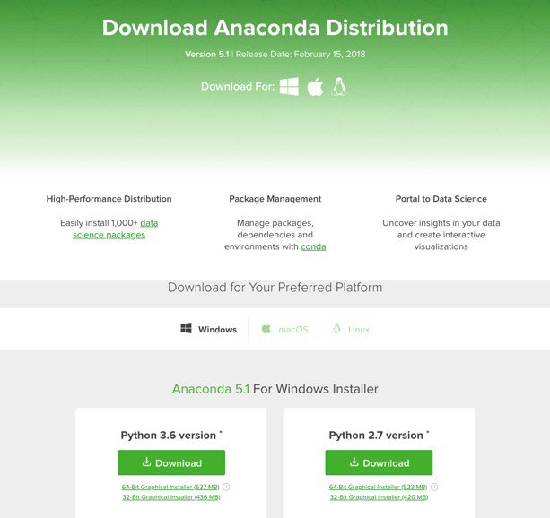
Python Distributions
A bundled collection of Python and many of the useful packages
There are several flavors
Anaconda
Enthought Canopy
Python.org
Your system python, ArcGIS or QGIS python

Slide 14
Python Versions
Python 2.7 will not be maintained past 2019
https://pythonclock.org
Python 3.5+ is now the standard
We are using Python 3.7 for the class

Slide 15
Resources for “best practices”
“Cookiecutter” template for packaging, testing, documenting, and publishing scientific Python code: https://nsls-ii.github.io/scientific-python-cookiecutter/index.html
PEP8 python style guide: https://www.python.org/dev/peps/pep-0008/
Numpy doc string format: https://numpydoc.readthedocs.io/en/latest/format.html
”Good enough” practices for scientific computing: https://swcarpentry.github.io/good-enough-practices-in-scientific-computing/

